Slide 1
P109 - Summary Extraction along with sentimental analysis.
Presented by Group 6 :
Samrat Pawar
Siddhesh Patil
Ansari Inam
Pranali Chaudhari
Mentor : Karthik & Dhanya

Slide 2
Business Objective :
Extract the ebook summary then categorized its content as positive , negative and neutral by building/using an nlp model.

Slide 3

Dataset Details
Ebook No - 2600
Author - Tolstoy.Leo.graf 1828-1910
Tittle - War and Peace
Subject - War Stories
Napoleonic Wars, 1800-1815 -- Campaigns -- Russia -- Fiction
Russia -- History -- Alexander I, 1801-1825 -- Fiction
Aristocracy (Social class) -- Russia -- Fiction

Slide 4
External Sources and packages
We have kept the usage of external librairies varied to keep the tasks simplistic and easy to explain and to demonstrate my understanding and usage of the same
nltk
gensim
spacy

Slide 5
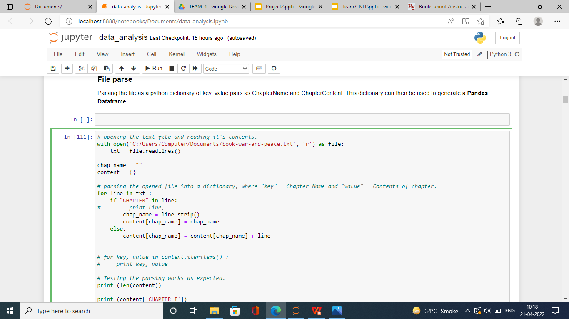
Extracting the Text Data
File Parse
Parsing the file as a python dictionary of key, value pairs as ChapterName and ChapterContent. This dictionary can then be used to generate a Pandas Dataframe.

Slide 6
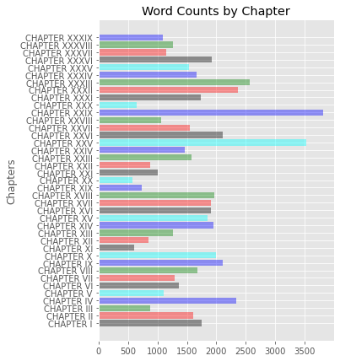
Wordcloud Distribution
Chapterwise word distribution. WordClouds - show most frequently occuring words, with higher frequency words corelating to high font size. Generating wordCloud showing the most frequently occurring words per Chapter.

Slide 7
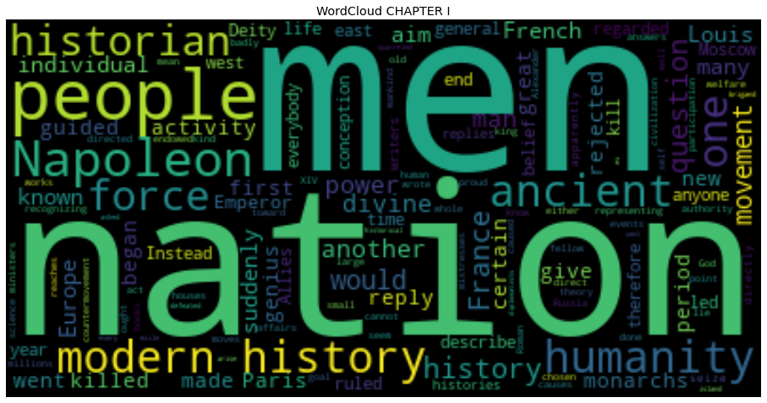
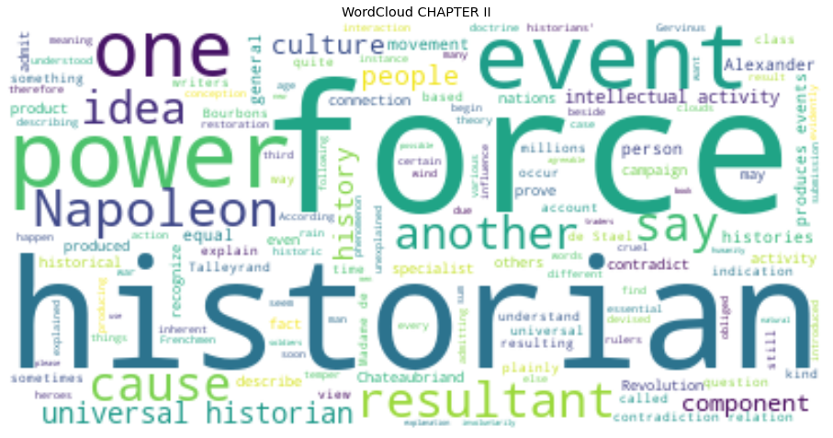
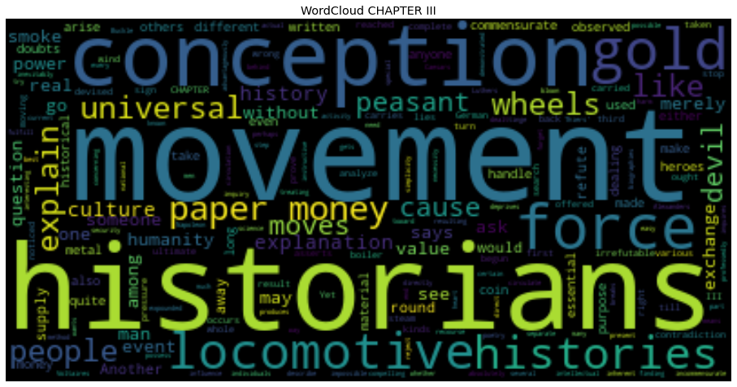
Generating wordCloud showing the most frequently occurring words per Chapter

Slide 8
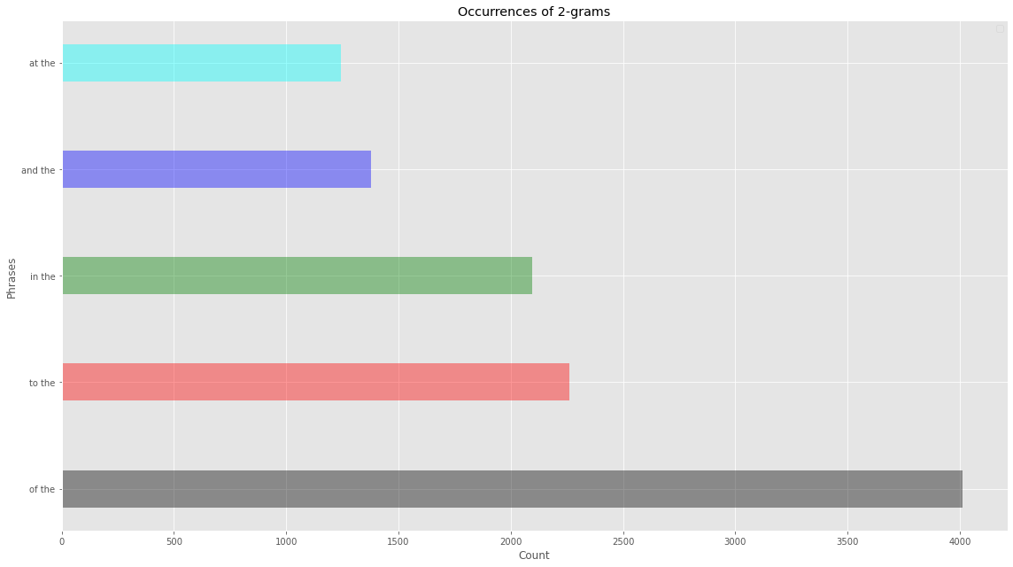
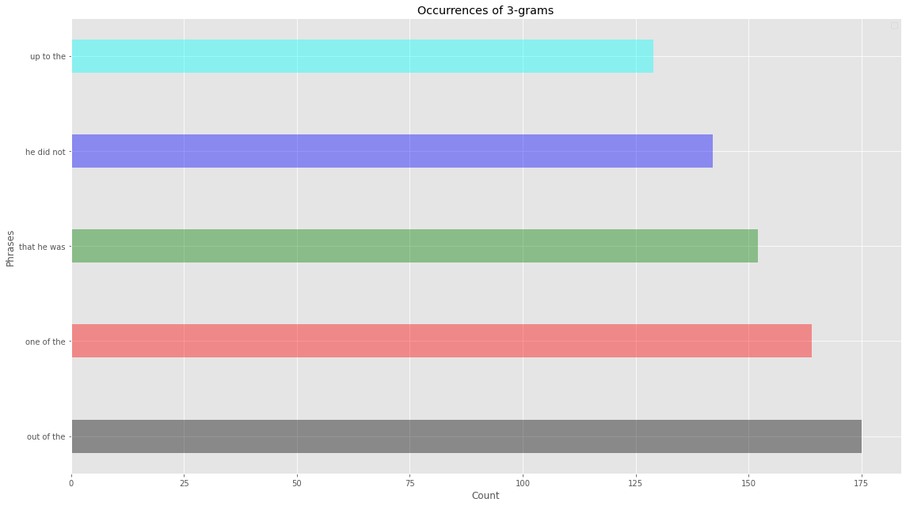
Phrase Distribution:
Performing Phrase distribution(s) throughout the whole book and then for individual Chapter(s).
counting till n-grams, n ranging from 2 to 5 .

Slide 9
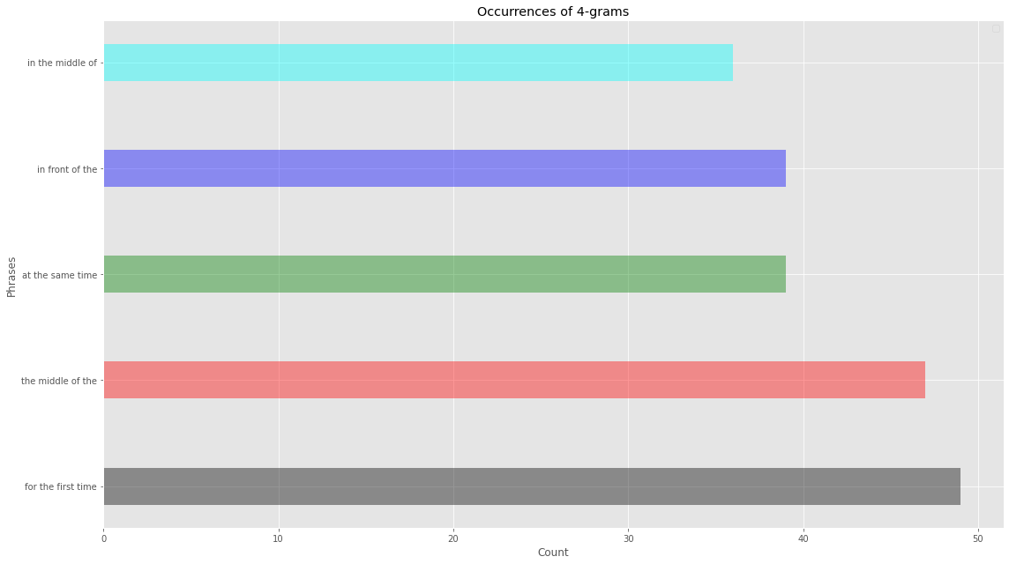
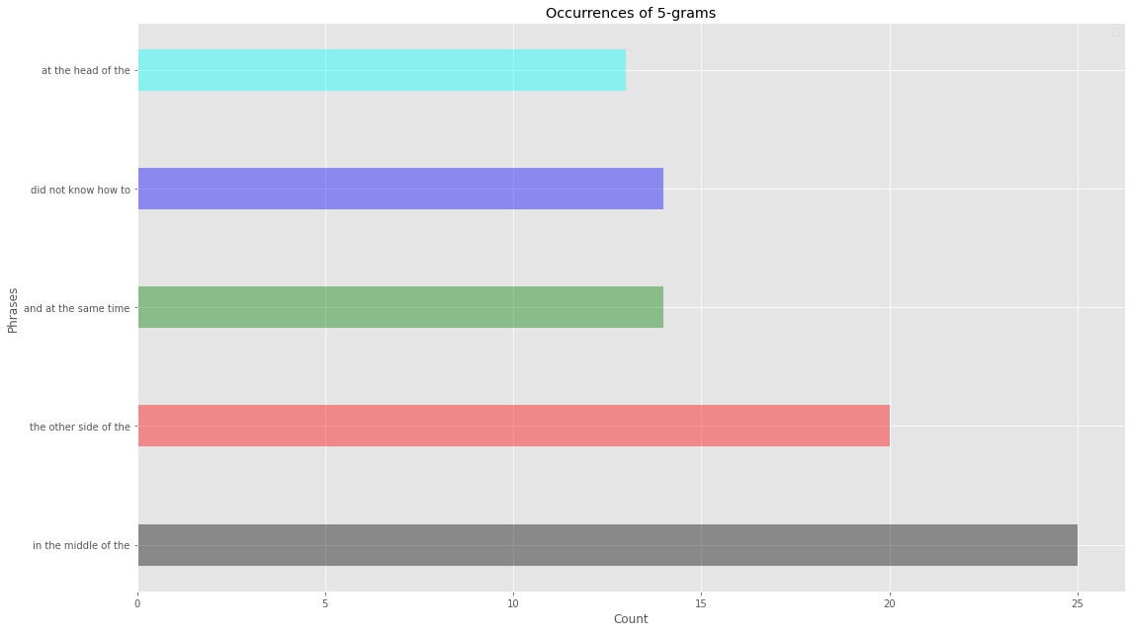

Slide 10
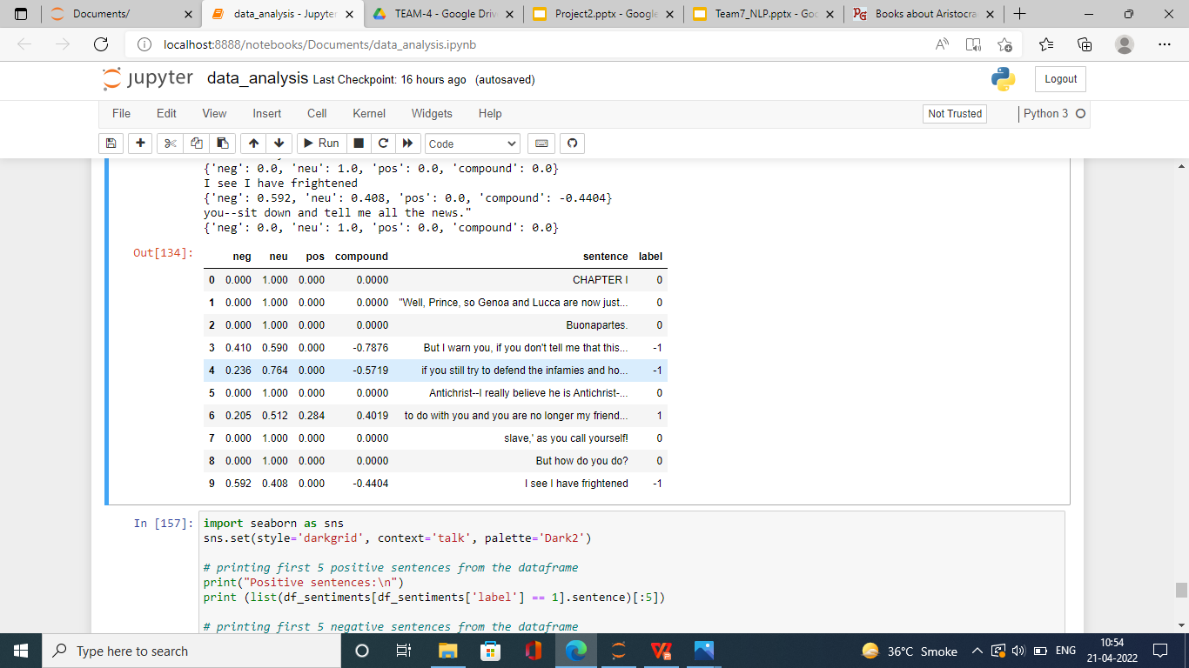
Sentimental Analysis
Here we attempt to get the sentiment of each line in the whole document based on NLTK's Vader Analyzer. In order to keep the task simplistic, refraining from training a Neural network architecture (LSTM or CNN) for this, as it will need the training to be done on some other labelled data set and then utilize transfer learning to work on this piece of text.
Instead I use NLTK, and label sentences polarity based on the polarity score of it's individual words. The sentiment scoring consists of 4 tags : Neu, Neg, Pos and compound. The first three represent the sentiment score percentage of each category in our sentence, and the compound single number that scores the sentiment. compound ranges from -1 (Extremely Negative) to 1 (Extremely Positive).
I have considered sentences with a compound
value greater than 0.2 as positive and less than -0.2
as negative.
The label column in data frame refers to the sentiment of the sentence, 0 being neutral, +1 positive and -1 negative respectively.

Slide 11
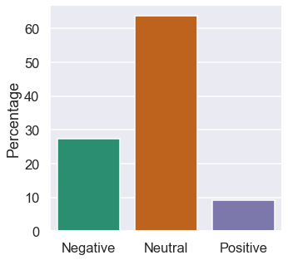

Slide 12
Text Summarizer:
Here we are creating summary of each Chapter, using Gensim's summarizer.
This summarizer is based on TextRank algorithm which is losely similar to PageRank algorithm used by Google.
Text is converted to graph with vertices and edges and the more a sentence is linked by other sentence the higher it's score grows. Summary is generated by top high scoring sentences.

Slide 13
MODEL BUILDING
Naive Bayes Classifier for Multinomial Model
Linear Support Vector Machine
Logistic Regression
Random Forest Classifier

Slide 14
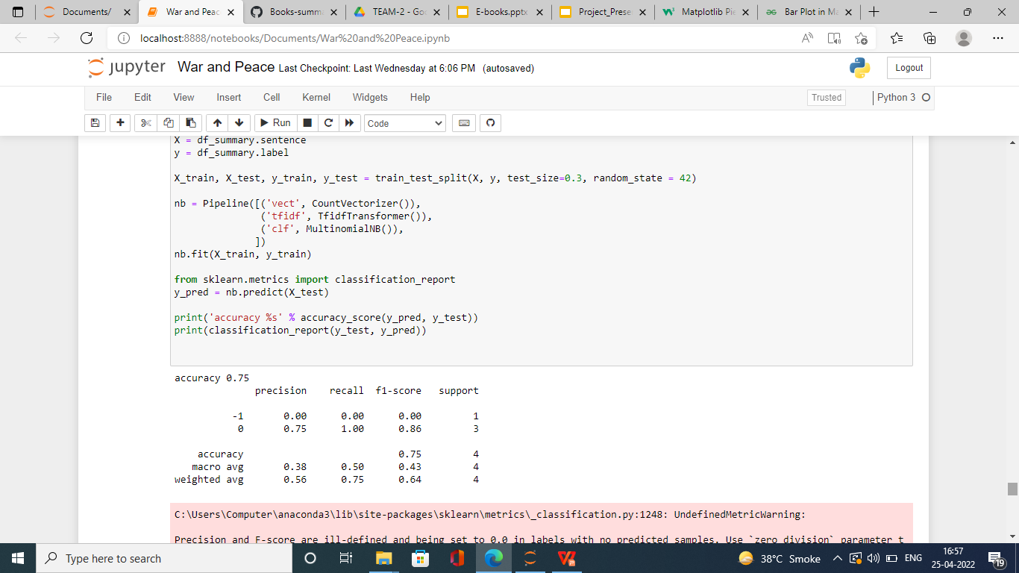
Naive Bayes Classifier for Multinomial Models:
The multinomial Naive Bayes classifier is suitable for classification with discrete features (e.g., word counts for text classification). The multinomial distribution normally requires integer feature counts. However, in practice, fractional counts such as tf-idf may also work.

Slide 15
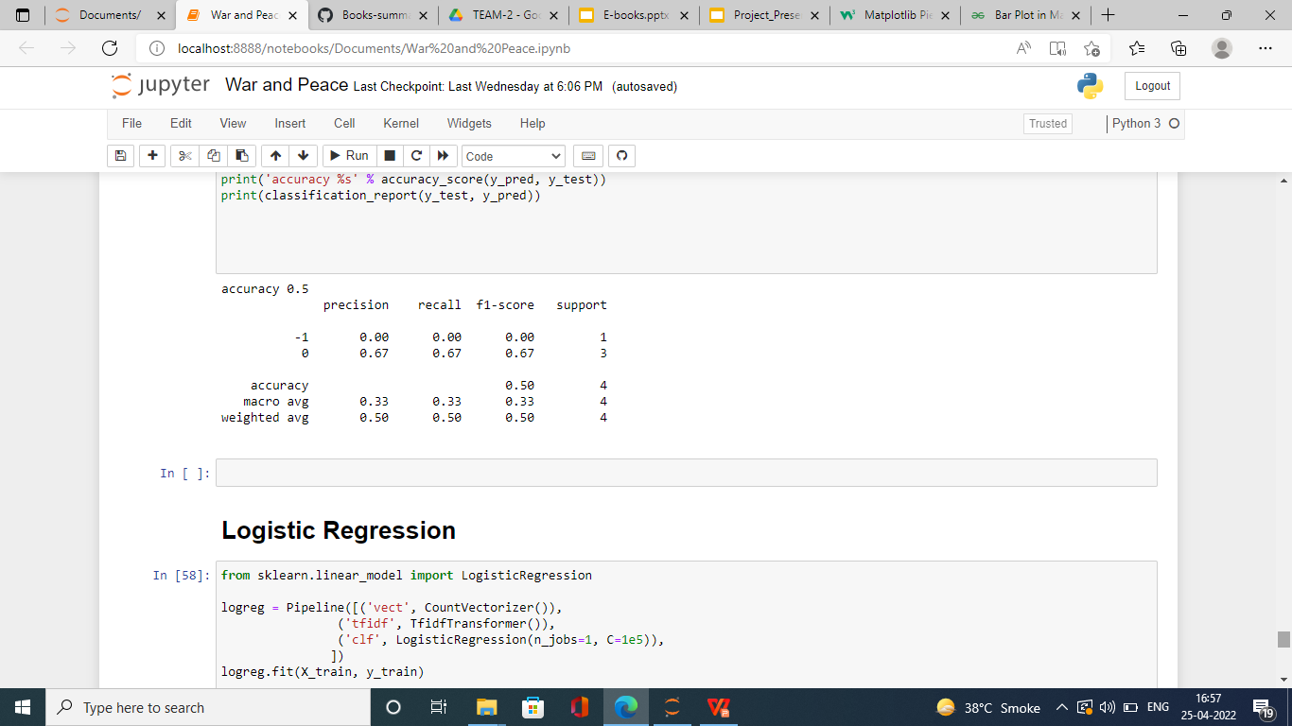
Linear Support Vector Machine:
The objective of the support vector machine algorithm is to find a hyperplane in an N-dimensional space(N — the number of features) that distinctly classifies the data points.

Slide 16
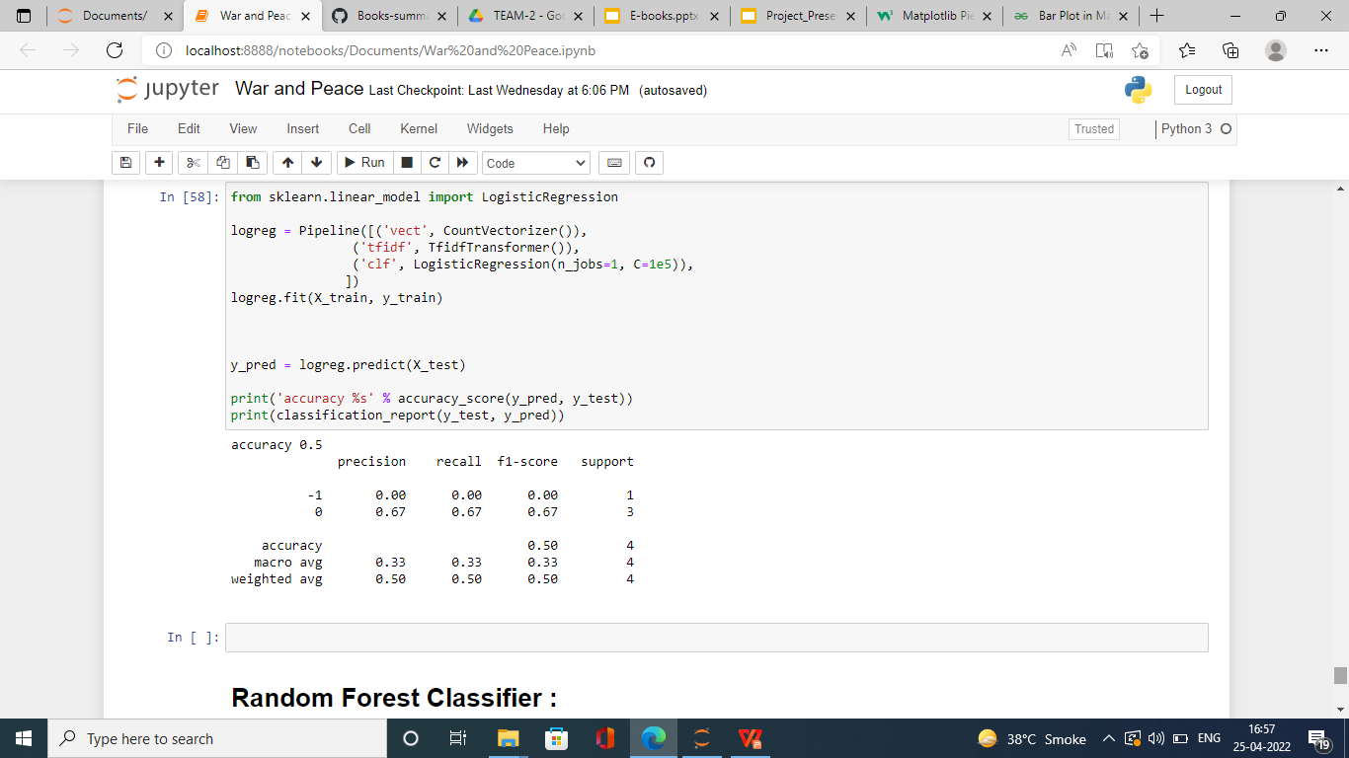
Logistic Regression:
Logistic regression is a classification algorithm. It is used to predict a binary outcome based on a set of independent variables.
A binary outcome is one where there are only two possible scenarios—either the event happens (1) or it does not happen (0). Independent variables are those variables or factors which may influence the outcome (or dependent variable).

Slide 17
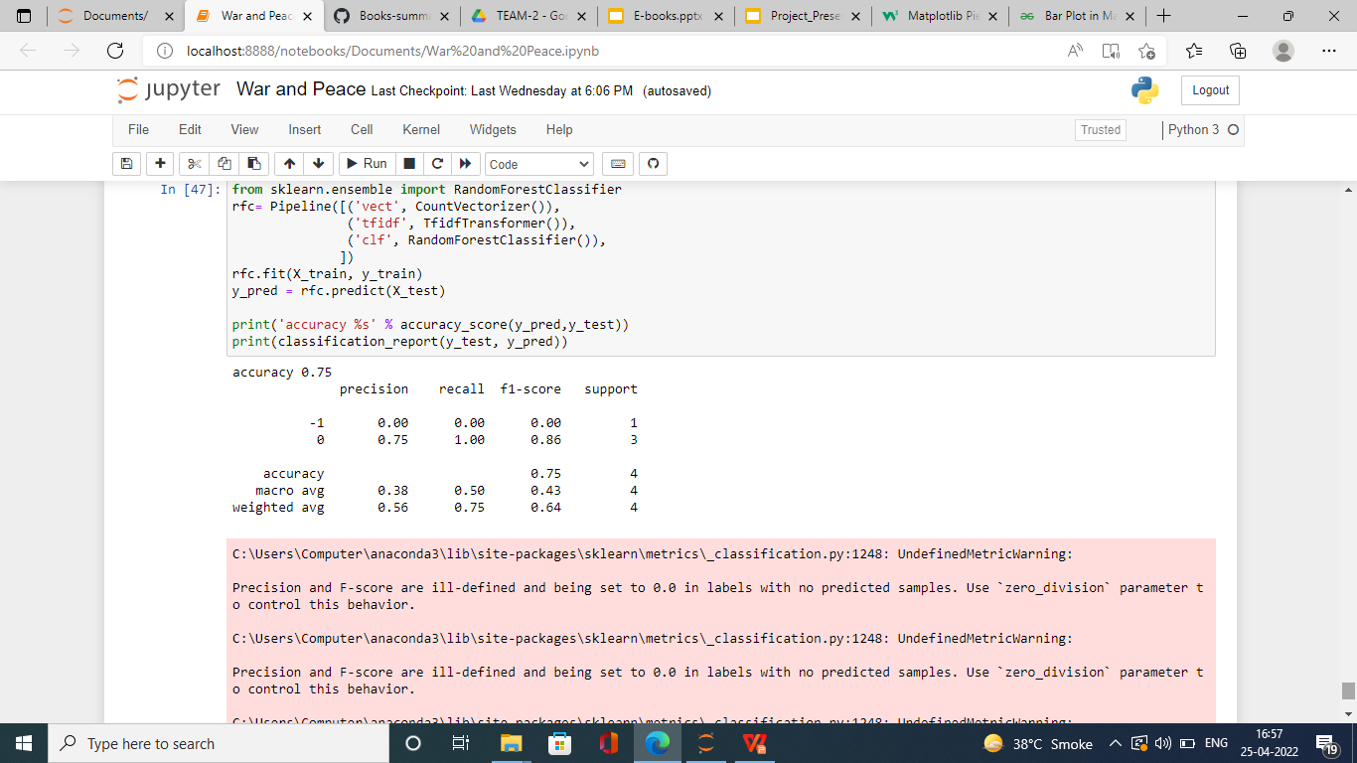
Random Forest Classifier:
Random forest is a supervised learning algorithm which is used for both classification as well as regression. But however, it is mainly used for classification problems.
Random forest algorithm creates decision trees on data samples and then gets the prediction from each of them and finally selects the best solution by means of voting. It is an ensemble method which is better than a single decision tree because it reduces the over-fitting by averaging the result.

Slide 18
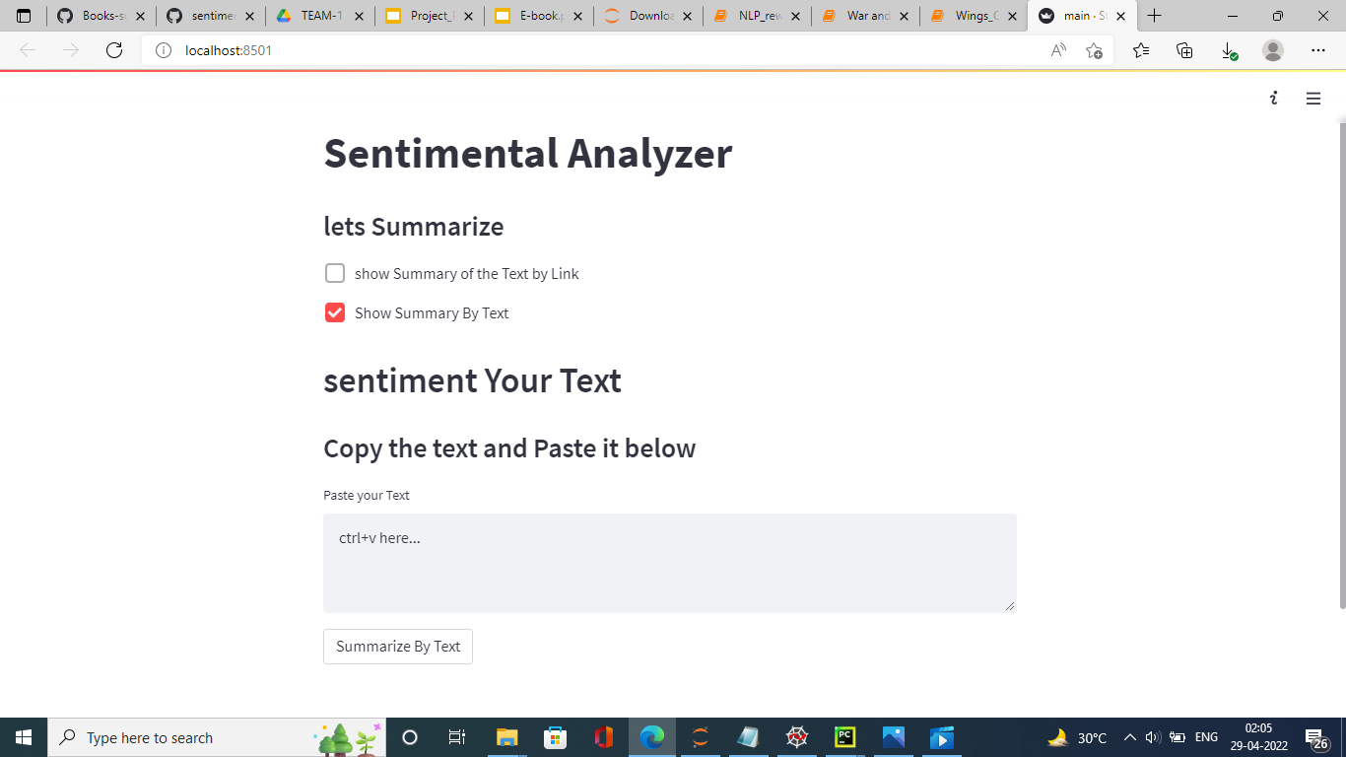
Model Deployment using Streamlit

Slide 19
Challenges Faced :
Book with the much more pages were a problem to read in jupyter itself. Then we changed the configuration through code and increased the max limit of jupyter.
The challenges in the deployment part were that we were not able parse the file to the main function .
We we stuck at the making of .py file, but through the help of other friends we solve the problem.

Slide 20
Thank you

